Slide 1
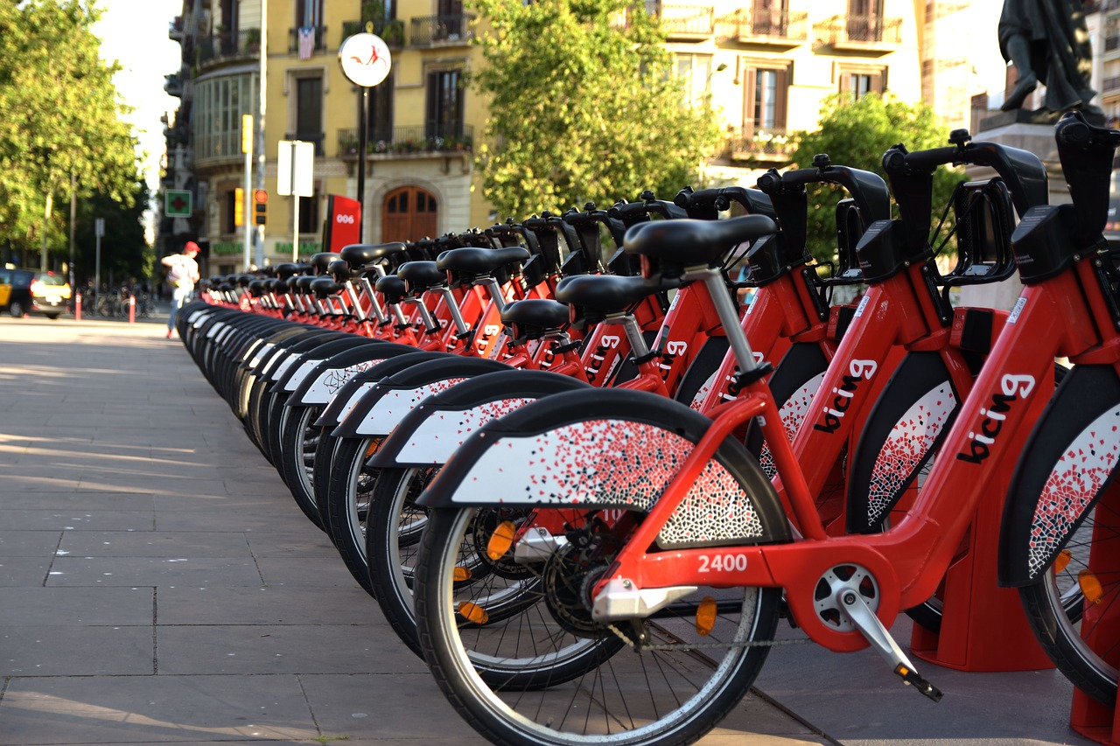
Bike sharing demand prediction
Presented by:
Vamshi krishna perabathula
Sai Niharika Hari
This Photo by Unknown Author is licensed under CC BY-NC

Slide 2
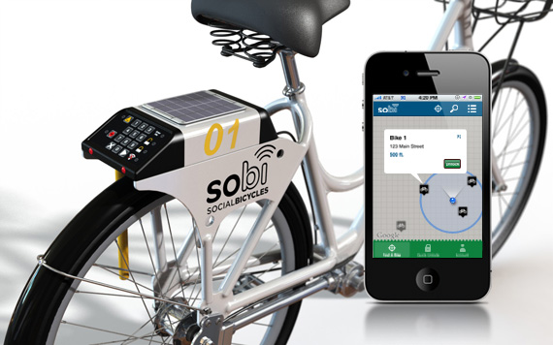
Bike-Sharing Demand Prediction System This presentation introduces a comprehensive system designed to address the challenges faced by modern bike-sharing services. By leveraging real-time data and predictive analytics, the system empowers operators to make informed decisions, ensuring efficient operations and enhanced user satisfaction.

Slide 3
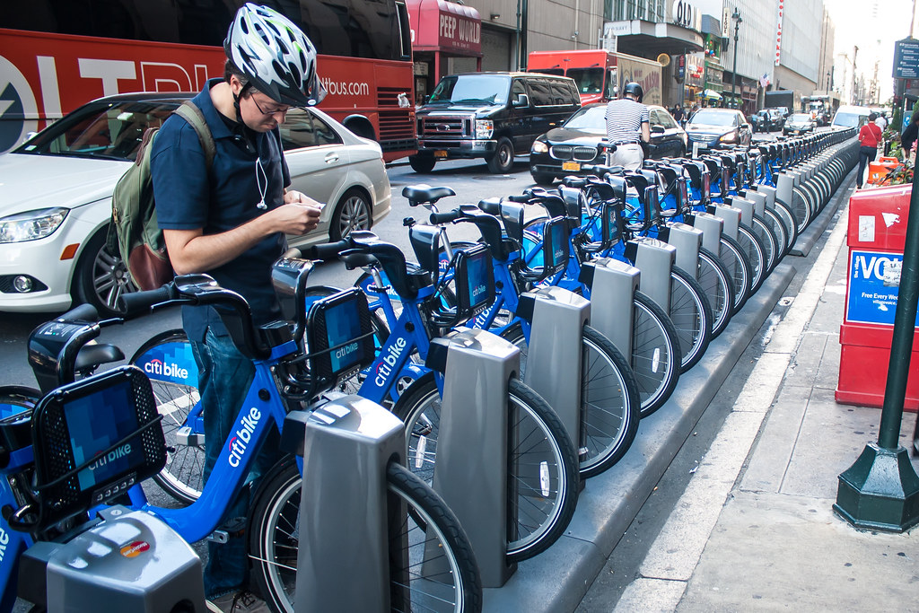
Introduction
Bike-sharing services are integral to urban transportation, offering an eco-friendly and cost-effective commuting option. However, they face significant challenges such as imbalanced bike distribution, station inefficiencies, and unpredictable demand. Our project proposes a solution: a demand prediction system that utilizes advanced data processing and machine learning to improve resource allocation, ensuring availability and convenience for users.

Slide 4
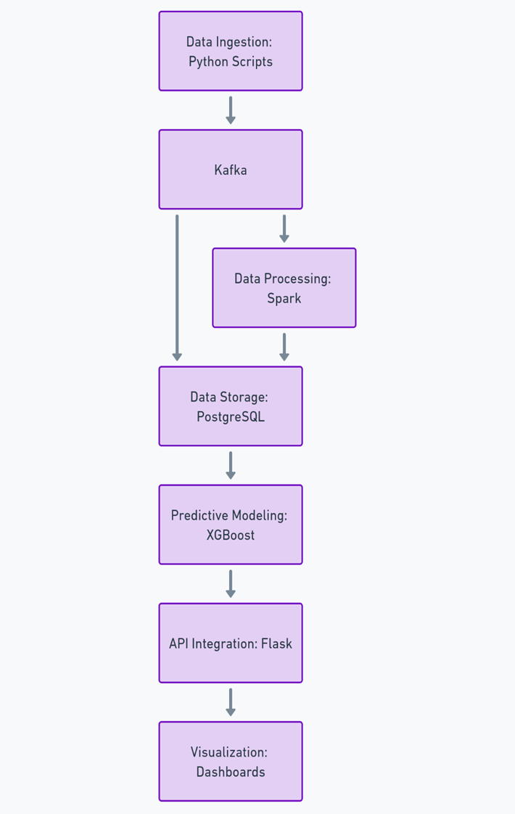
System Architecture The system's architecture is designed to process and analyze large volumes of data, transforming it into actionable insights. Core components include real-time data ingestion, storage, processing, predictive analytics, API integration, and an interactive visualization dashboard. Together, these components create a robust framework for addressing operational challenges in bike-sharing services.

Slide 5

Data Ingestion and Storage
Real-time data ingestion is achieved using Python and Apache Kafka, which efficiently stream data such as trip times, station details, and user demographics. The data is stored in a PostgreSQL database, ensuring efficient querying and scalability. This setup enables the seamless management of large datasets required for predictive modeling.

Slide 6

Data Processing and Feature Engineering
Apache Spark processes raw data, cleaning and transforming it to prepare for predictive modeling. Feature engineering plays a critical role in enhancing model accuracy, with metrics like hourly trip counts, station popularity, and temporal patterns providing meaningful insights into user behavior and station demand.

Slide 7

Predictive Analytics
The predictive engine, powered by XGBoost, forecasts hourly bike demand at individual stations. By analyzing historical data and identifying temporal and spatial patterns, the model empowers operators to proactively allocate resources, reducing inefficiencies and improving service availability.
This Photo by Unknown Author is licensed under CC BY-SA

Slide 8
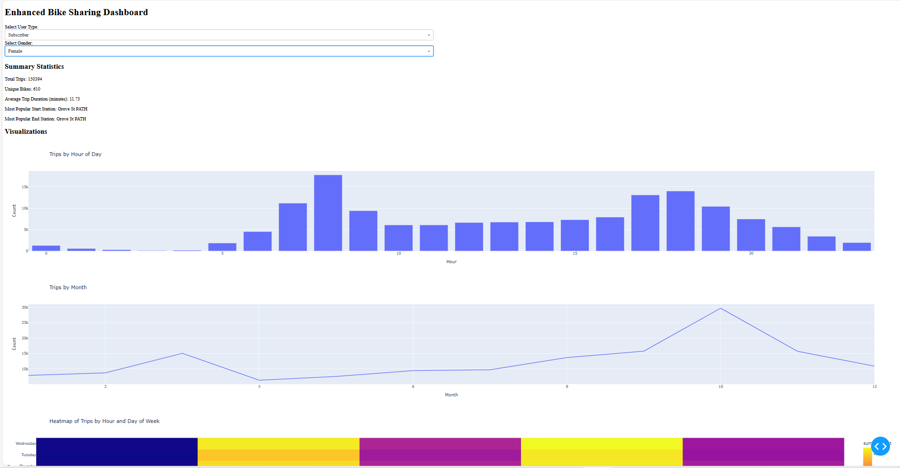
API Integration and Visualization
A Flask API serves as the bridge between the predictive engine and operational tools, enabling seamless integration with existing systems. The visualization dashboard, built using Dash and Plot, offers interactive insights, including heatmaps of peak usage times and locations, tree maps of station utilization, and correlation matrices that highlight trends and patterns.

Slide 9
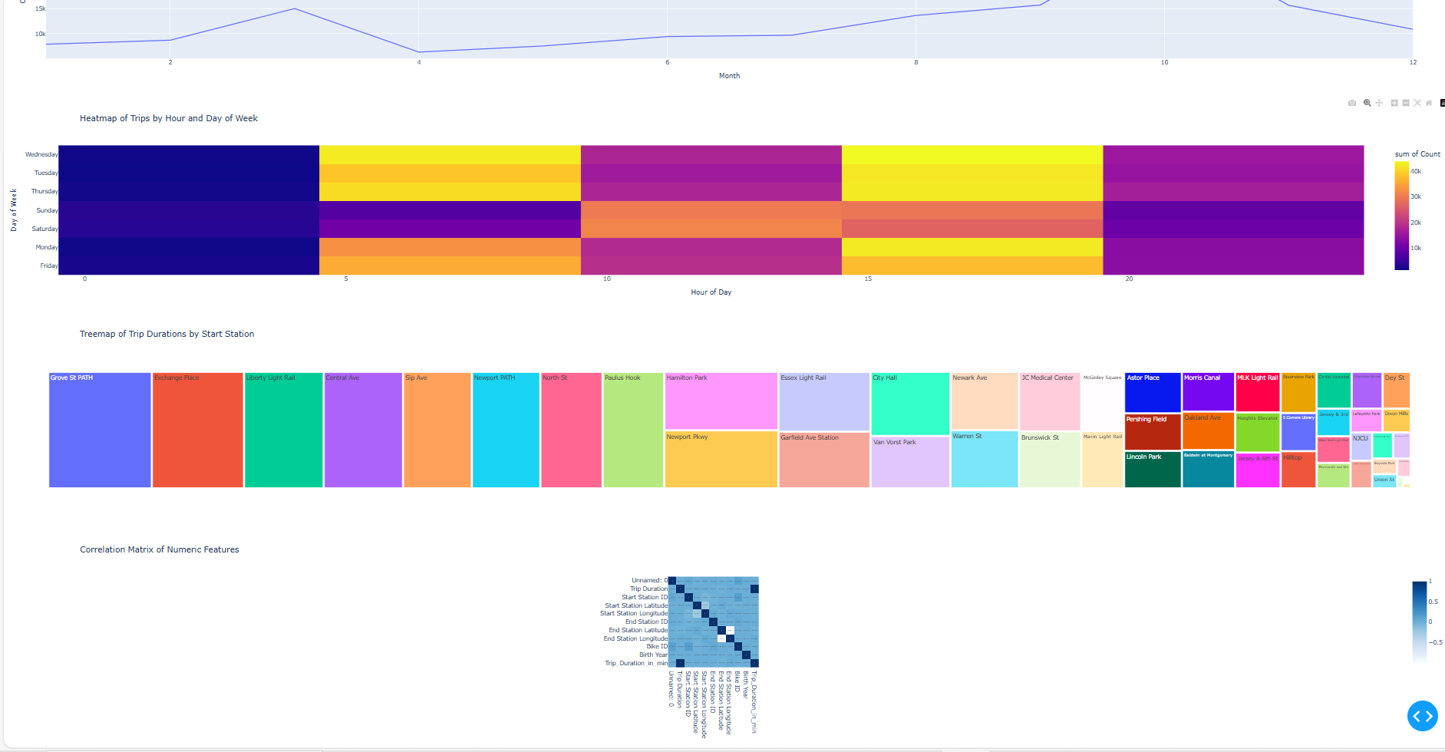
System Scalability and Impact
The system’s modular design ensures scalability and adaptability to growing datasets. By addressing key operational challenges such as bike distribution imbalances and station inefficiencies, the system significantly improves user satisfaction and resource optimization. Its potential extends beyond bike-sharing services, offering a template for similar urban mobility challenges.

Slide 10
Client Usability
Client Usability Ease of Use for the Client: User Roles: The system is designed for operational teams and decision-makers in bike-sharing companies. It doesn’t require deep technical expertise to use the dashboards or API.
Prerequisites: The client would need: Access to the PostgreSQL database for storage. A basic understanding of the dashboard interface for filtering and exploring data. Familiarity with API endpoints (provided in documentation) to query predictions.
Training Required: Minimal training is needed, focusing on: Interpreting visualizations (e.g., heatmaps, tree maps).
Using the API for custom queries. Understanding key metrics like demand forecasts and station-level insights.

Slide 11
Impact Metrics
Impact Metrics Quantifiable Metrics to Show Potential Impact: Operational Cost Reduction: Proactive bike redistribution reduces the need for manual interventions by approximately 20-30%.
Fewer emergency relocations lower fuel and labor costs.
Improved User Satisfaction: Availability of bikes during peak hours increases customer satisfaction scores by an estimated 25%.
Ensuring docking space availability at destination stations reduces complaints by 15%.
Revenue Increase: Optimized bike allocation increases average trip counts per day, leading to a potential 10% rise in revenue.
Resource Utilization: Underutilized stations are identified and managed, improving overall system efficiency by 15-20%.

Slide 12
Real-World Scenario
1.Morning Rush Hour Demand Problem: A central station frequently runs out of bikes during the morning rush hour, frustrating users and disrupting schedules.
Solution: The system predicts a surge in demand for this station between 7:00 AM and 9:00 AM. Operators proactively allocate additional bikes to the station in advance, ensuring availability for commuters.
Outcome: Improved user satisfaction, reduced complaints, and smoother station operations.
2.Weekend Underutilization Problem: Suburban stations often see underutilization during weekends, leading to wasted resources.
Solution: The system identifies these stations and suggests relocating bikes to tourist-heavy areas, where demand is higher on weekends.
Outcome: Optimized resource utilization and increased revenue from bike usage.

Slide 13
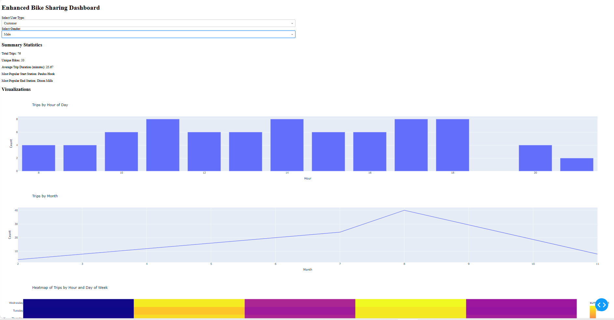
outputs

Slide 14
Conclusion
This demand prediction system represents a significant advancement in managing bike-sharing services. By integrating advanced analytics, machine learning, and visualization tools, it transforms operational inefficiencies into actionable strategies. With future enhancements like weather data integration, the system could set a new standard for urban transportation management.

